Slide 1
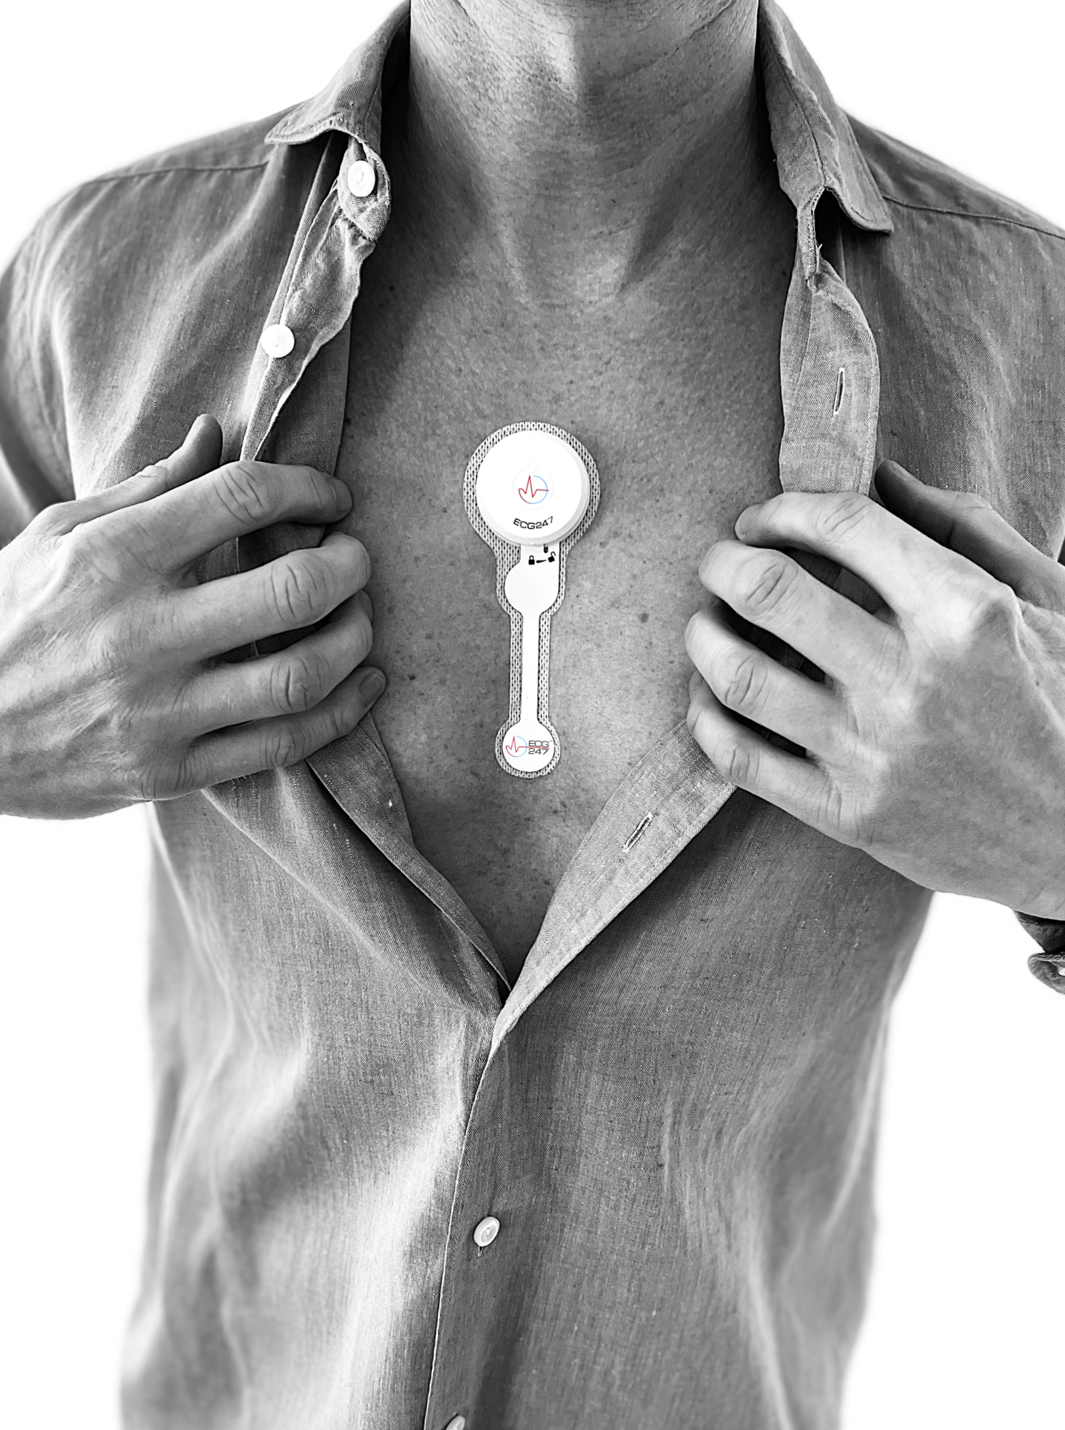


>60,000 participants
in clinical trials with ECG247
Research and clinical trials

Slide 2
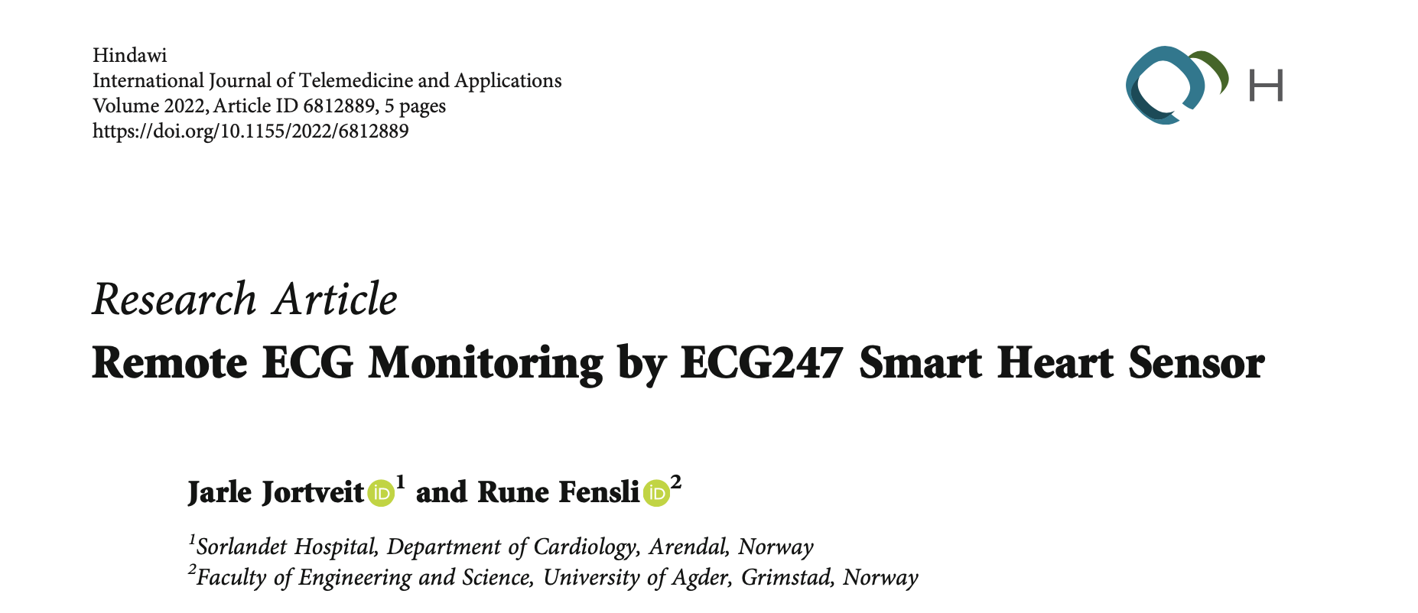
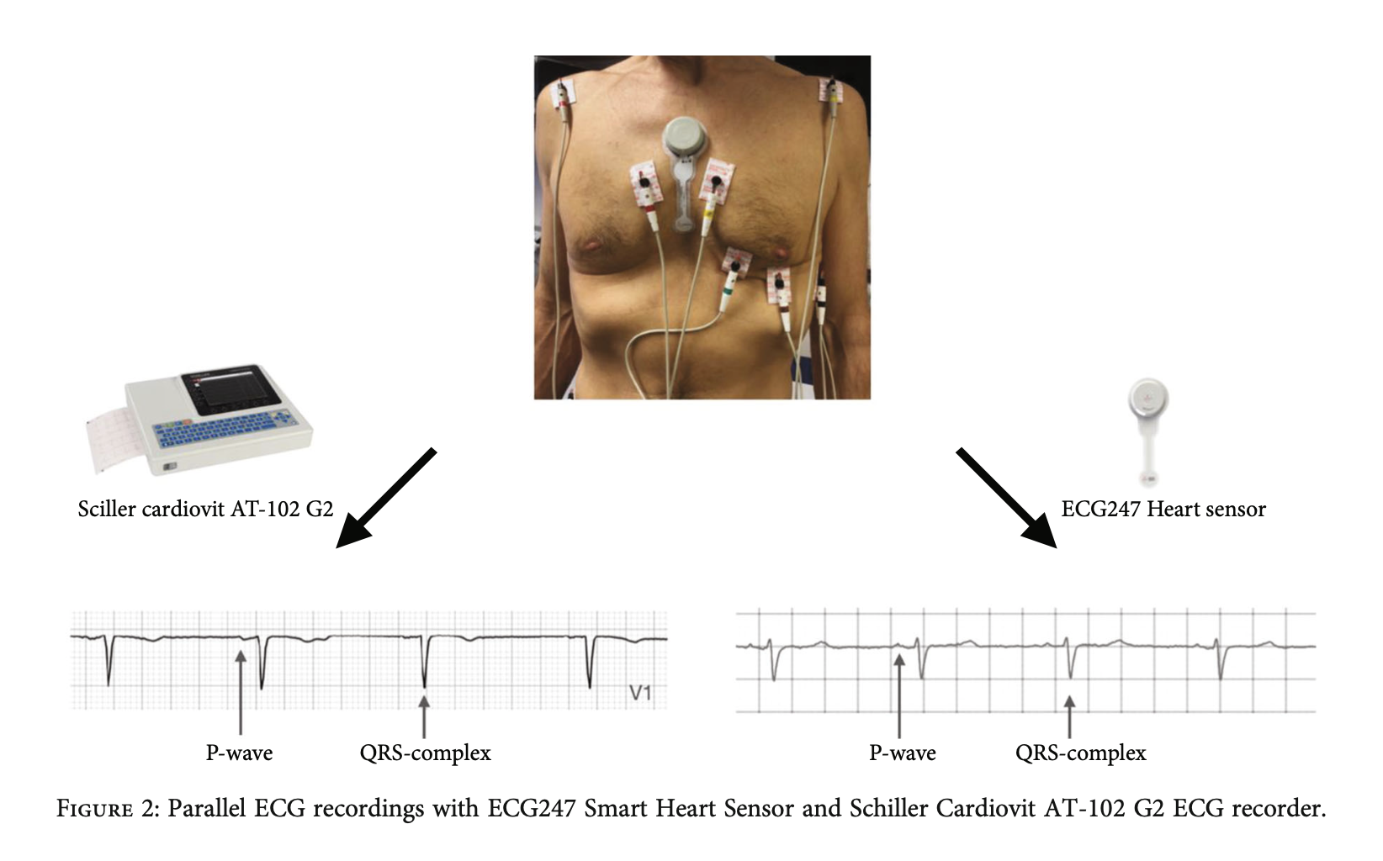
ECG quality
High ECG quality
Jortveit J, Fensli R. Remote ECG Monitoring by ECG247 Smart Heart Sensor. International Journal of Telemedicine and Applications. 2022;2022:6812889.

Slide 3

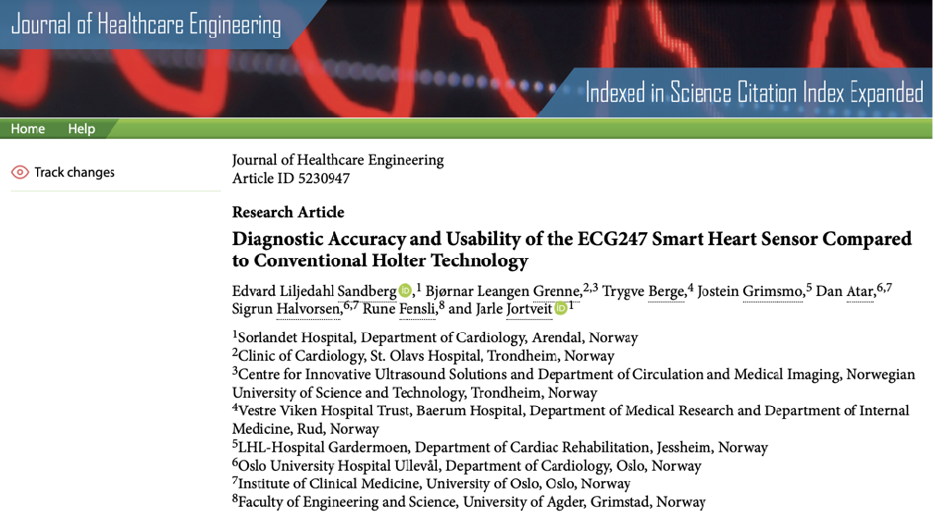

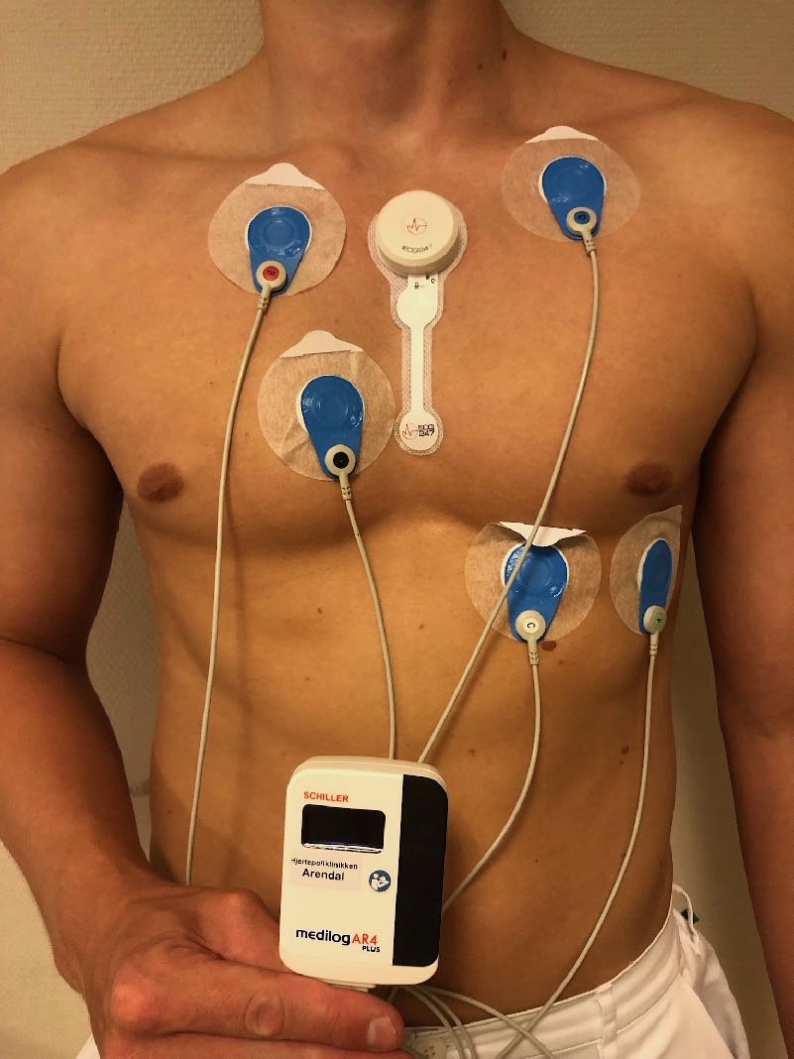
Diagnostic accuracy
Comparable to traditional Holter technology
Sandberg EL, Grenne BL, Berge T, Grimsmo J, Atar D, Halvorsen S, et al. Diagnostic Accuracy and Usability of the ECG247 Smart Heart Sensor Compared to Conventional Holter Technology. Journal of Healthcare Engineering. 2021;2021:5230947.

Slide 4
Usability
Holter
ECG247
67.5
87.4
High usability score
Sandberg EL, Grenne BL, Berge T, Grimsmo J, Atar D, Halvorsen S, et al. Diagnostic Accuracy and Usability of the ECG247 Smart Heart Sensor Compared to Conventional Holter Technology. Journal of Healthcare Engineering. 2021;2021:5230947.

Slide 5
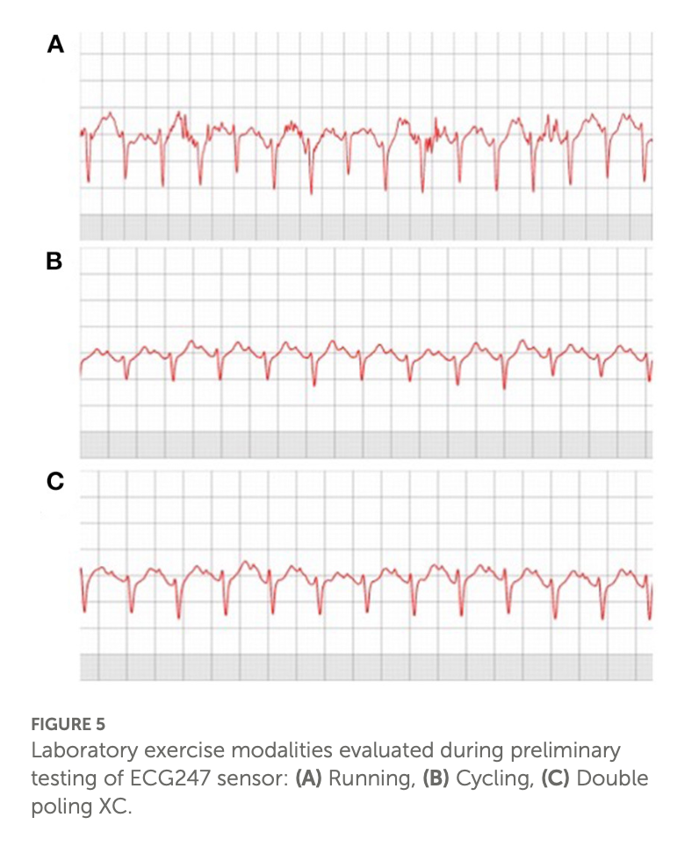
Exercise
Robust signal quality during physical activity
Ausland Å, Sandberg EL, Jortveit J, Seiler S. Heart rhythm assessment in elite endurance athletes: A better method? Frontiers in Sports and Active Living. 2022;4
Hans Halvor Bjørnstad, Tor Halvor Bjørnstad-Tuveng, Edvard Liljedahl Sandberg, Nina Hjertvikrem, Jian Chen; Atrial Fibrillation in 63-Year-Old Former Elite Endurance Athletes: A 38-Year Follow-Up Study. Biomed Hub 1 January 2025; 10 (1): 191–196
Apelland T, Sellevold AB, Letnes JM, et al Cardiac arrhythmia assessment with patch electrocardiogram versus insertable cardiac monitor: a cohort study in endurance athletes with atrial fibrillation BMJ Open 2025;15:e093250. doi: 10.1136/bmjopen-2024-093250

Slide 6
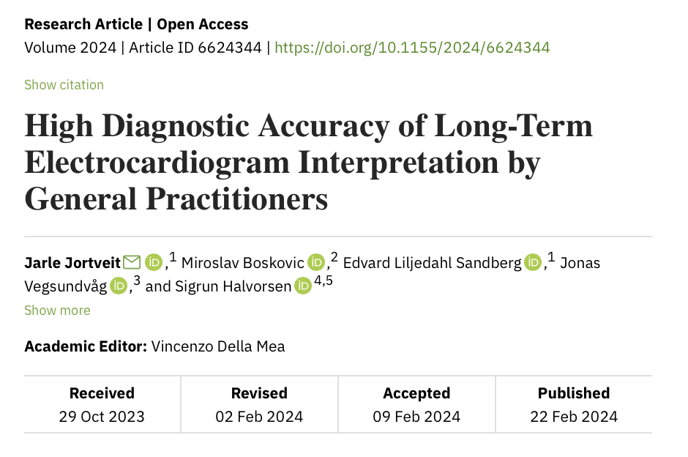
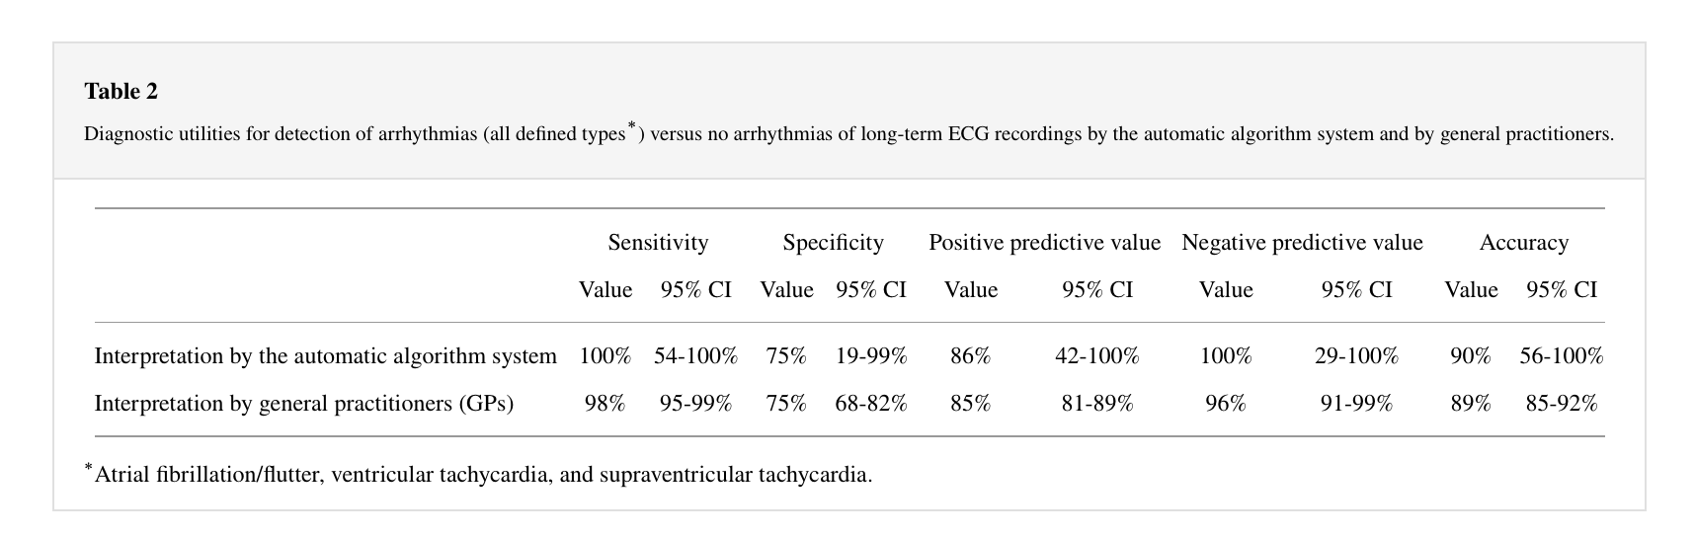
Interpretation by GPs
Easy to interpretate
Jortveit J, Boskovic M, Sandberg EL, Vegsundvåg J, Halvorsen S. High Diagnostic Accuracy of Long-Term Electrocardiogram Interpretation by General Practitioners. International Journal of Telemedicine and Applications. 2024;2024:6624344.

Slide 7
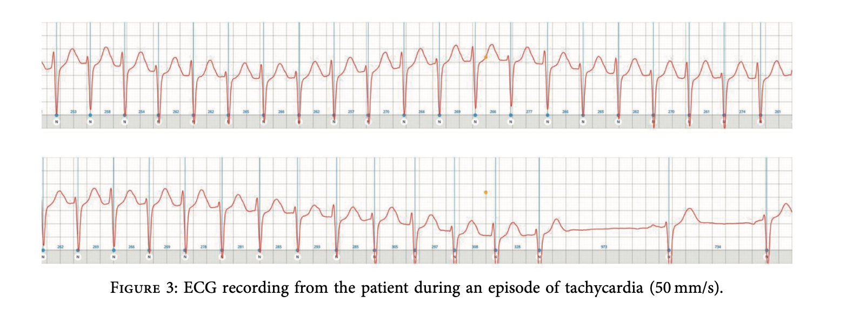
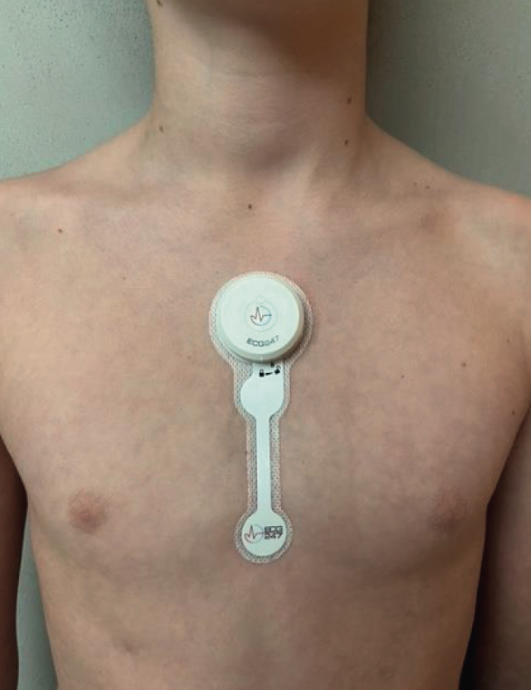
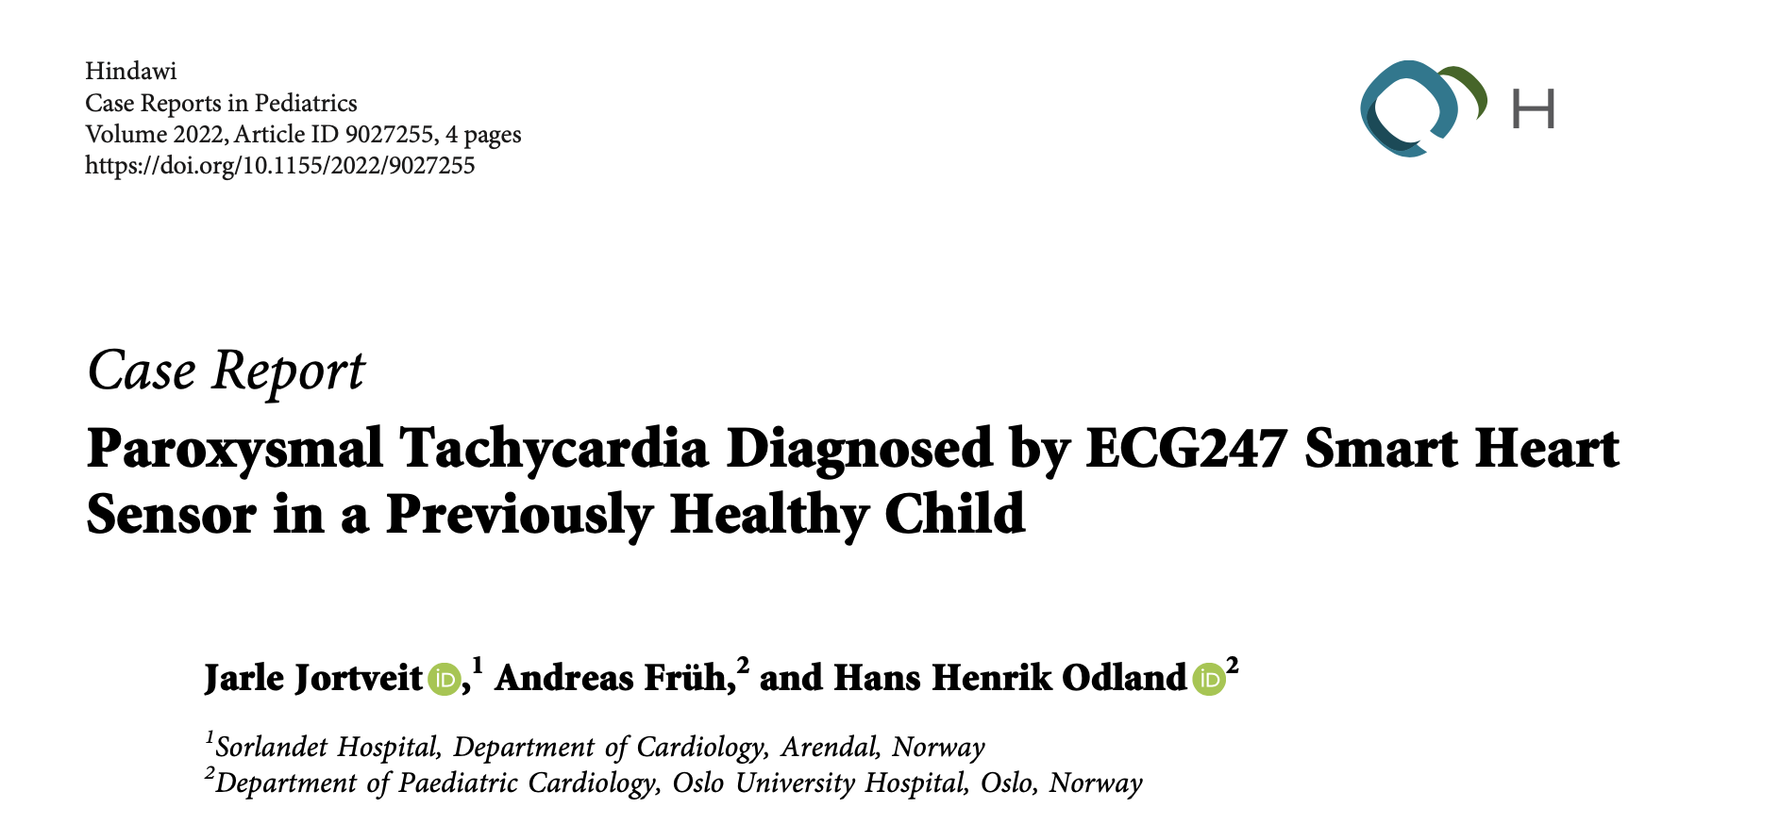
Children
Suitable for use in children
Jortveit J, Früh A, Odland HH. Paroxysmal Tachycardia Diagnosed by ECG247 Smart Heart Sensor in a Previously Healthy Child. Case Rep Pediatr. 2022;2022:9027255.

Slide 8
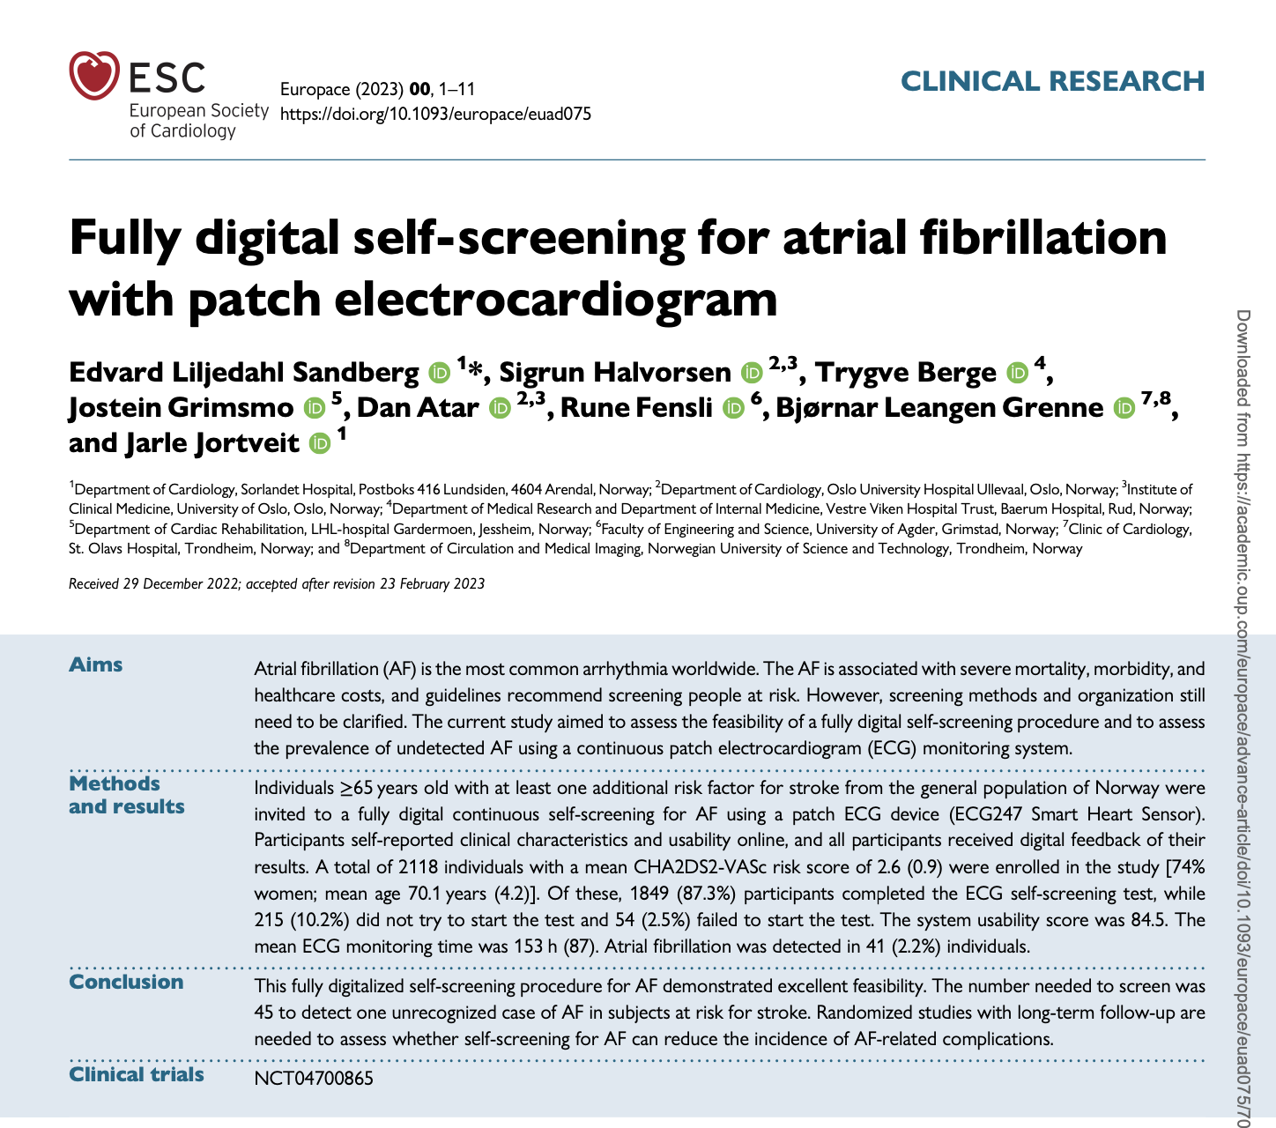

Self-screening for atrial fibrillation
AF screening conducted at home
Sandberg EL, Halvorsen S, Berge T, Grimsmo J, Atar D, Fensli R, et al. Fully digital self-screening for atrial fibrillation with patch electrocardiogram. Europace : European pacing, arrhythmias, and cardiac electrophysiology : journal of the working groups on cardiac pacing, arrhythmias, and cardiac cellular electrophysiology of the European Society of Cardiology. 2023;25(5).

Slide 9

Self-screening for atrial fibrillation
2118
87%
High completion rate
Sandberg EL, Halvorsen S, Berge T, Grimsmo J, Atar D, Fensli R, et al. Fully digital self-screening for atrial fibrillation with patch electrocardiogram. Europace : European pacing, arrhythmias, and cardiac electrophysiology : journal of the working groups on cardiac pacing, arrhythmias, and cardiac cellular electrophysiology of the European Society of Cardiology. 2023;25(5).
Notes:
74% kvinner
Snitt alder 70 år
Kun 3 av 13% som ikke gjennomførte test forsøkte.
6,5 døgn test
AF hos 4.3% av mennene og 1.5% av kvinnene
88% paroksystisk AF
Median tid til AF 47 timer
81% hadde nattlig AF episoder

Slide 10

Self-screening for atrial fibrillation
Test duration dependent AF detection
Sandberg EL, Halvorsen S, Berge T, Grimsmo J, Atar D, Fensli R, et al. Fully digital self-screening for atrial fibrillation with patch electrocardiogram. Europace : European pacing, arrhythmias, and cardiac electrophysiology : journal of the working groups on cardiac pacing, arrhythmias, and cardiac cellular electrophysiology of the European Society of Cardiology. 2023;25(5).

Slide 11
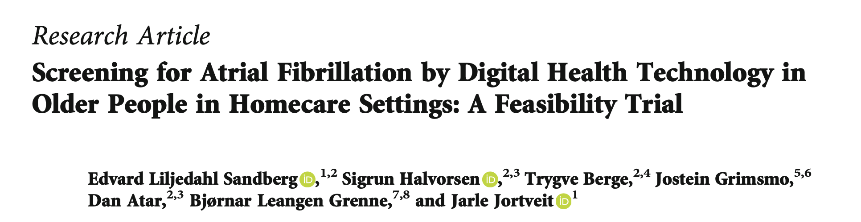
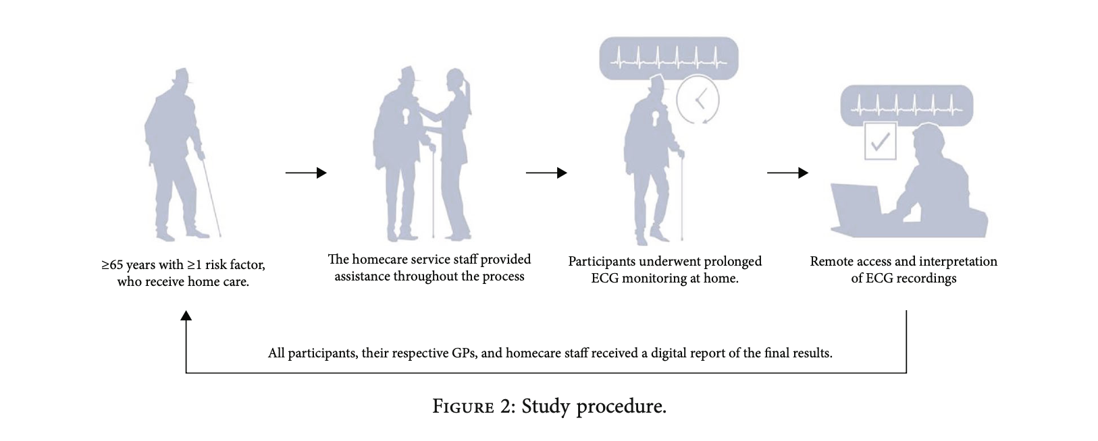
Home-care users
Suitable for use in older individuals
Sandberg EL, Halvorsen S, Berge T, Grimsmo J, Atar D, Grenne BL, et al. Screening for Atrial Fibrillation by Digital Health Technology in Older People in Homecare Settings: A Feasibility Trial. International Journal of Telemedicine and Applications. 2024;2024:4080415.

Slide 12
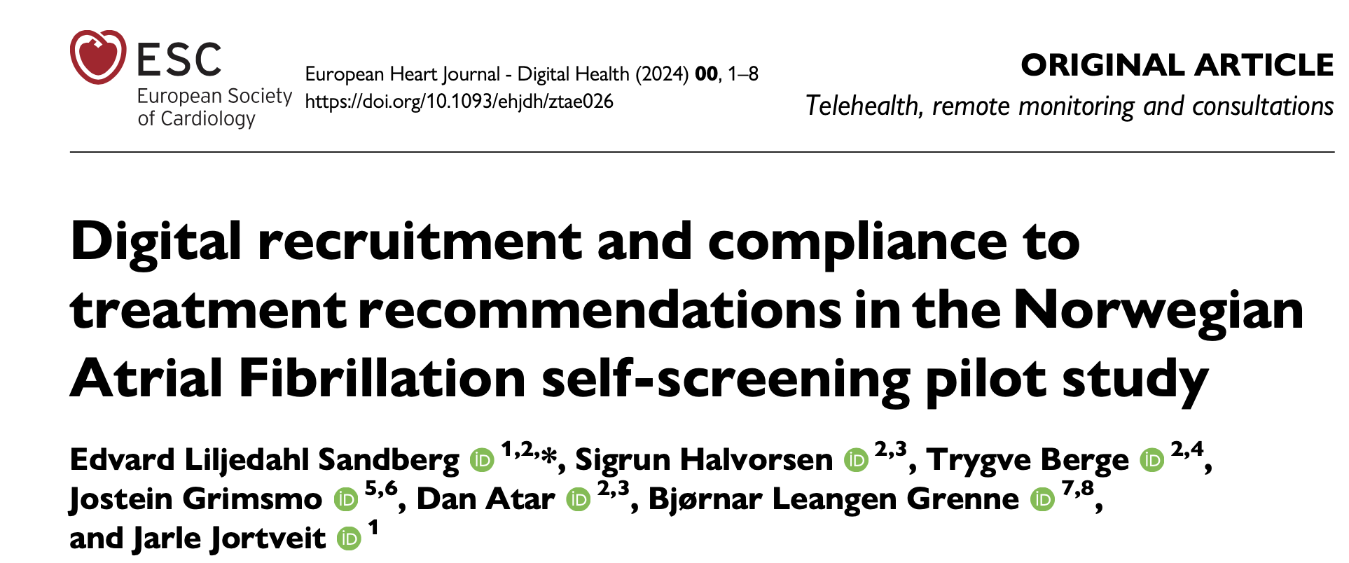
Compliance
Trusted by health care professionals
Sandberg EL, Halvorsen S, Berge T, Grimsmo J, Atar D, Leangen Grenne B, et al. Digital recruitment and compliance to treatment recommendations in the Norwegian Atrial Fibrillation self-screening pilot study. European Heart Journal - Digital Health. 2024.

Slide 13
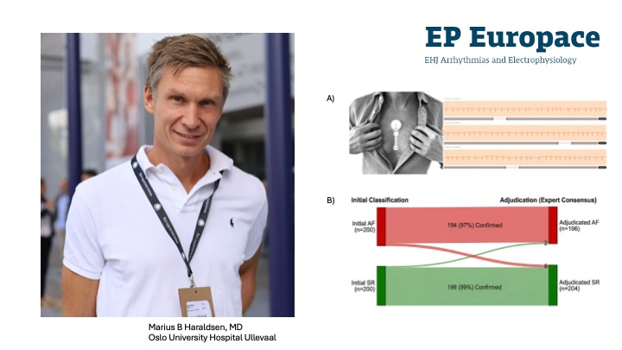
Reliability
Diagnostic certainty
Marius B Haraldsen, Miroslav Boskovic, Trygve Berge, Bjørnar L Grenne, Per Torger Skretteberg, Jarle Jortveit, Sigrun Halvorsen, Interrater agreement in atrial fibrillation diagnosis using one-week single-lead patch ECG monitoring: Findings from the NORSCREEN trial, EP Europace, 2026;, euag162, https://doi.org/10.1093/europace/euag162

Slide 14

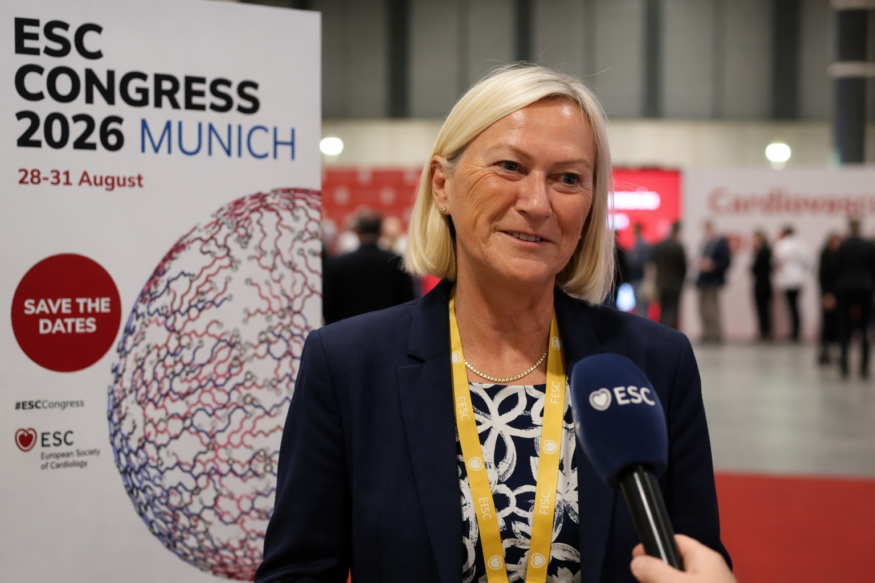
Ongoing national large-scale AF-screening
>50,000 participants
norscreen.org
Miroslav Boskovic, Jarle Jortveit, Marius Blørstad Haraldsen, Trygve Berge, Johan Engdahl, Maja-Lisa Løchen, Peter Schuster, Edvard Liljedahl Sandberg, Jostein Grimsmo, Dan Atar, Ole-Gunnar Anfinsen, Are Hugo Pripp, Bjørnar Leangen Grenne, Sigrun Halvorsen, The NORwegian atrial fibrillation self-SCREENing trial (NORSCREEN): Rationale and design of a randomized controlled trial, EP Europace, 2024;, euae228,
Jarle Jortveit, Miroslav Boskovic, Marius B Haraldsen, Trygve Berge, Bjørnar L Grenne, John Munkhaugen, Sigrun Halvorsen, Cardiac-related symptoms in individuals ≥65 years without diagnosed cardiac disease: insights from the NORSCREEN-trial, European Heart Journal Open, 2026;, oeag032,

Slide 15



Ongoing large-scale population-based trials
https://www.ntnu.edu/hunt
https://uit.no/research/tromsoundersokelsen

